Slide 1
Presentation brief for MCT’s
Title of presentation | Training Optimal Models
Presentation length | 120 minutes (including labs)
Audience | Data Scientists planning to operate machine learning workloads on Azure
Purpose | Describe how to tune hyperparameters in Azure Machine Learning Describe how to use Automated Machine Learning
(think) Student key takeaways | Hyperparameter tuning works well to optimize performance when an algorithm is already selected Automated Machine Learning works well to find the best algorithm and preprocessing options for your data
(feel) Student desired mindset | Encouraged to try different model optimization techniques based on data and target metric
(do) Student outcomes | Train a model using hyperparameter tuning Train a model using Automated Machine Learning
More information | For course feedback, please use the MCT Forums

Slide 2

Module 8: Training Optimal Models

Slide 3
Agenda
Hyperparameter Tuning : Sklearn.GridSearchCV
Automated Machine Learning : Sklearn.ensemble.VotingClassifier

Slide 4



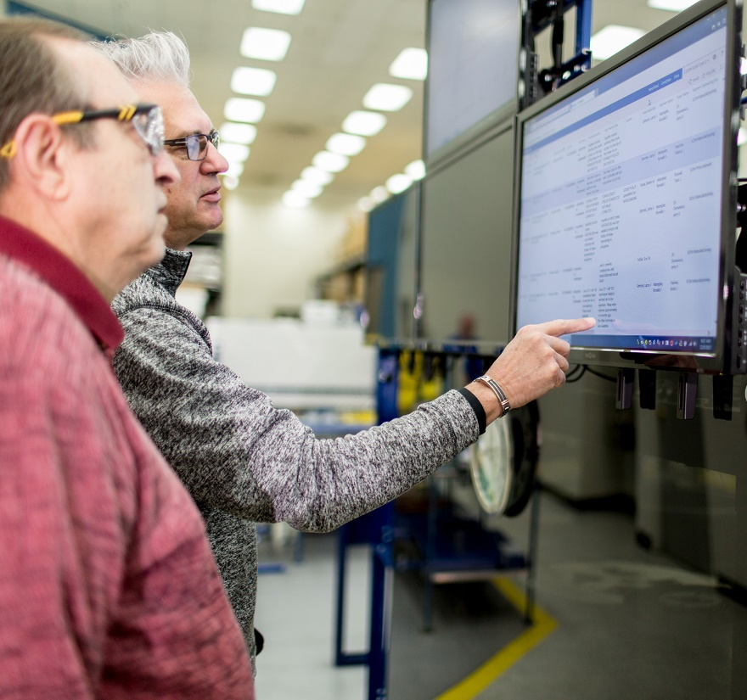









Lesson 1
Hyperparameter Tuning
Data
Cloud
AI

Slide 5


What is Hyperparameter Tuning?
Train multiple models, varying hyperparameter values
Find the "best" model based on a specific performance metric
0.01

0.1
1.0

Slide 6
Hyperparameter Search Space
Discrete Hyperparameters
Choice (any list or range)
From a discrete distribution (qnormal, quniform, qlognormal, qloguniform)
Continuous Hyperparameters
From a continuous distribution (normal, uniform, lognormal, loguniform)
param_space = {
'--batch_size': choice(30, 50, 100),
'--learning_rate': normal(10, 3)
}

Slide 7
Hyperparameter Sampling
Grid Sampling
Tries every combination of discrete hyperparameter values
Can only be used when all hyperparameters are discrete
Random Sampling
Randomly selects hyperparameter values
Can be used with discrete and continuous hyperparameter combinations
Bayesian Sampling
Selects hyperparameter values based on performance of previous selection
Can only be used with choice, uniform, and quniform hyperparameters
from azureml.train.hyperdrive import RandomParameterSampling
param_sampling = RandomParameterSampling(param_space)

Slide 8
Early Termination Policy 提早停止
Evaluate primary metric at intervals and compare to previous runs
Bandit Policy: 貪婪，見好就收，不想要嘗試其他可能方式
Stop if metric underperforms the best run so far by a specified margin
Median Stopping:
Stop if metric is worse than median of running averages
Truncation Selection:
Stop if metric is in the worst X% of all runs at the same interval
from azureml.train.hyperdrive import TruncationSelectionPolicy
stop_policy = TruncationSelectionPolicy(evaluation_interval=1,
truncation_percentage=20,
delay_evaluation=5)

Slide 9
Tuning Hyperparameters with Hyperdrive 多個參數使用
Log target metric in experiment script
Configure Hyperdrive run
run.log('Accuracy', model_accuracy)
hyperdrive = HyperDriveConfig(estimator=sklearn_estimator,
hyperparameter_sampling=param_sampling,
policy=stop_policy,
primary_metric_name='Accuracy',
primary_metric_goal=PrimaryMetricGoal.MAXIMIZE,
max_total_runs=6,
max_concurrent_runs=4)
hyperdrive_run = experiment.submit(config=hyperdrive)

Slide 10
Lab 8A
Tuning Hyperparameters
https://aka.ms/msl-dp100

Slide 11
Monitoring and Reviewing Hyperdrive Runs
Monitor runs in Azure Machine Learning studio or widget
Hyperdrive runs initiate child-runs for each hyperparameter combination:
List all runs by performance metric:
Find the best-performing run:
for child_run in hyperdrive_run.get_children():
print(child_run.id, child_run.get_metrics())
for child_run in hyperdrive_run.get_children_sorted_by_primary_metric():
print(child_run)
best_run = hyperdrive_run.get_best_run_by_primary_metric()

Slide 12
Lesson Review
Complete the Review Questions

Slide 13
Lesson 2
Automated Machine Learning
Data
Cloud
AI

Slide 14
What is Automated Machine Learning?
Train multiple models, varying algorithm and preprocessing
Find the "best" model based on a specific performance metric
LogisticRegression
DecisionTree
LinearSVM


Slide 15
Automated Machine Learning Algorithms
Default set of algorithms for machine learning tasks:
Classification
Regression
Time Series Forecasting
You can restrict the algorithms tested

Slide 16
Preprocessing and Featurization
Scaling and Normalization is applied automatically
Additional featurization can be applied:
Missing value imputation
Categorical encoding
Dropping high-cardinality features
Feature engineering
Others

Slide 17
Automated Machine Learning Data
Multiple ways to specify training and validation data:
Training Data – tabular data including features and label
Validation Data – optional table for model validation
X and Y – separate feature and label values
X_valid and Y_valid – features and labels for model validation

Slide 18
Running an Automated Machine Learning Experiment
User interface in Azure Machine Learning studio
Azure Machine Learning SDK
from azureml.train.automl import AutoMLConfig
automl_run_config = RunConfiguration(framework='python')
automl_config = AutoMLConfig(name='Automated ML Experiment',
task='classification',
primary_metric = 'AUC_weighted',
compute_target=aml_compute,
training_data = train_dataset,
validation_data = test_dataset,
label_column_name='Label',
featurization='auto',
iterations=12,
max_concurrent_iterations=4)
automl_run = automl_experiment.submit(automl_config)

Slide 19
Lab 8B
Using Automated Machine Learning
https://aka.ms/msl-dp100

Slide 20
Monitoring and Reviewing Automated ML Runs
Monitor runs in Azure Machine Learning studio or widget
Find the best-performing run and the model it trained:
View model pipeline details:
best_run, fitted_model = automl_run.get_output()
best_run_metrics = best_run.get_metrics()
for metric_name in best_run_metrics:
metric = best_run_metrics[metric_name]
print(metric_name, metric)
for step_ in fitted_model.named_steps:
print(step)

Slide 21
Lesson Review
Complete the Review Questions

